Slide 1
Chapter 1:
Data Storage

Slide 2
Chapter 1: Data Storage
1.1 Bits and Their Storage
1.2 Main Memory
1.3 Mass Storage
1.4 Representing Information as Bit Patterns
1.5 The Binary System

Slide 3
Chapter 1: Data Storage (continued)
1.6 Storing Integers
1.7 Storing Fractions
1.8 Data Compression
1.9 Communications Errors

Slide 4
Bits and Bit Patterns
Bit: Binary Digit (0 or 1)
Bit Patterns are used to represent information.
  Numbers
  Text characters
  Images
  Sound
  And others

Slide 5
Boolean Operations
Boolean Operation: An operation that manipulates one or more true/false values
Specific operations
  AND
  OR
  XOR (exclusive or)
  NOT

Slide 6
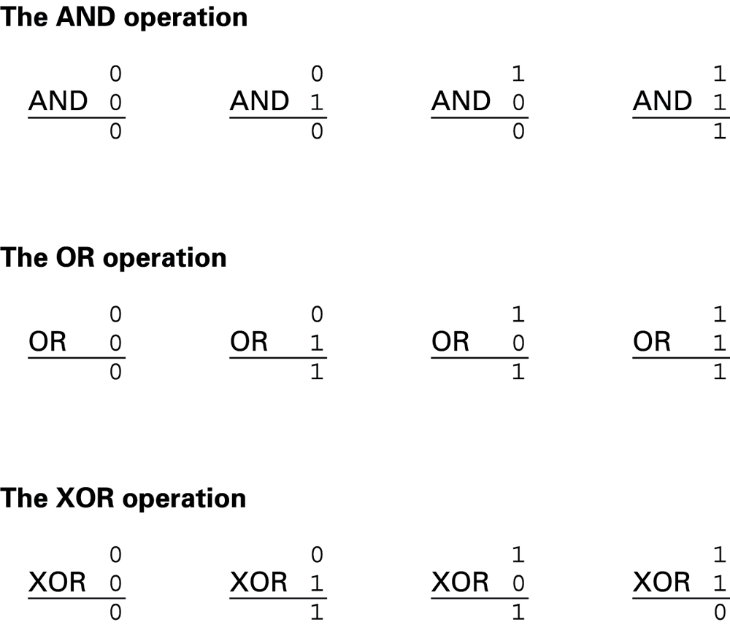
Figure 1.1 The Boolean operations AND, OR, and XOR (exclusive or)

Slide 7
Gates
Gate: A device that computes a Boolean operation
  Often implemented as (small) electronic circuits
  Provide the building blocks from which computers are constructed
  VLSI (Very Large Scale Integration)

Slide 8
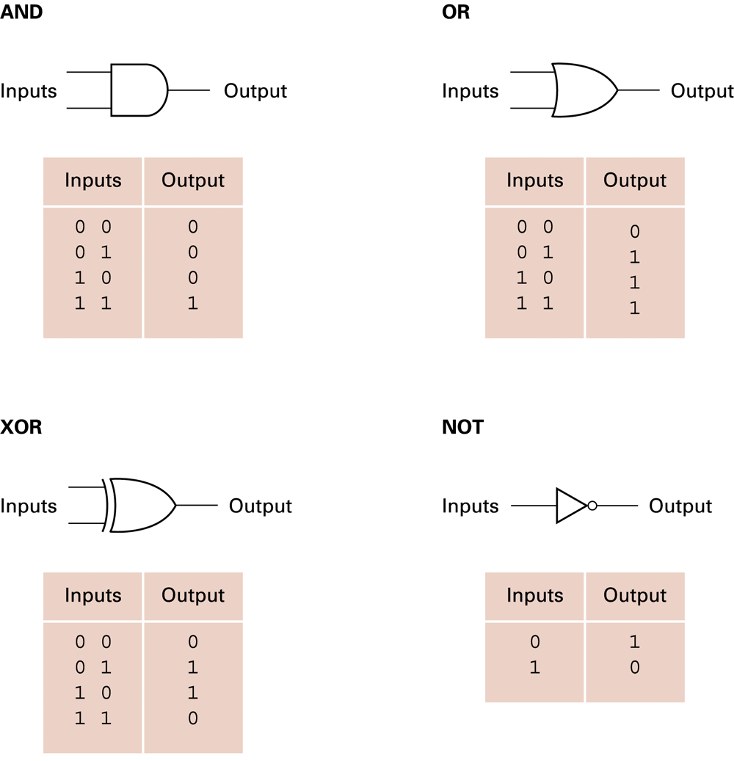
Figure 1.2 A pictorial representation of AND, OR, XOR, and NOT gates as well as their input and output values

Slide 9
Flip-flops
Flip-flop: A circuit built from gates that can store one bit.
  One input line is used to set its stored value to 1
  One input line is used to set its stored value to 0
  While both input lines are 0, the most recently stored value is preserved

Slide 10
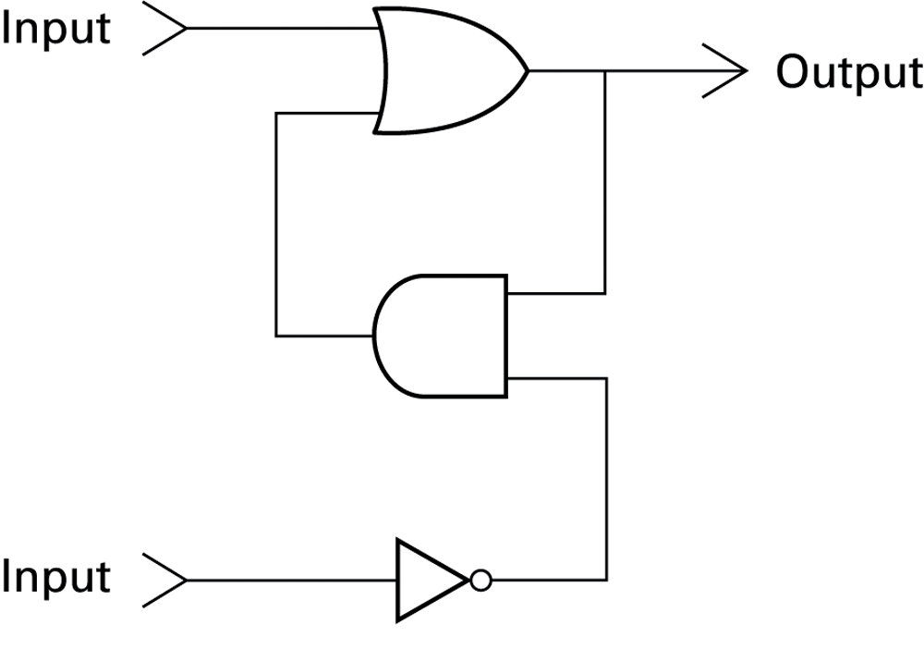
Figure 1.3 A simple flip-flop circuit

Slide 11
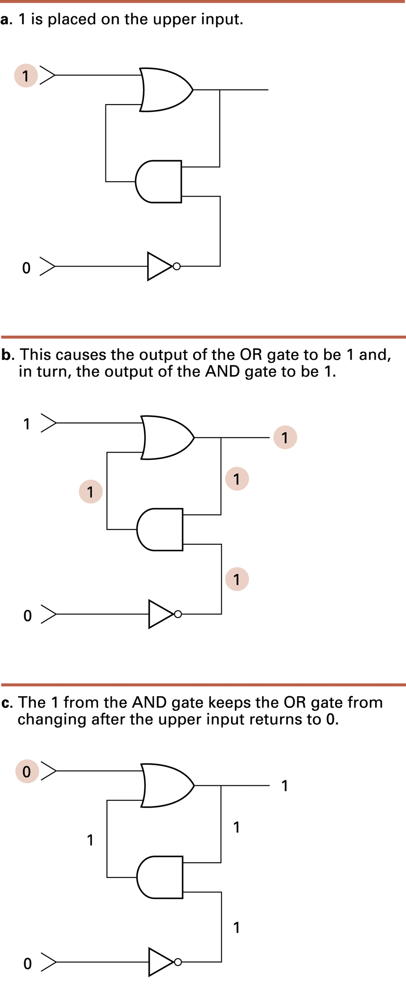
Figure 1.4 Setting the output of a flip-flop to 1

Slide 12
Figure 1.4 Setting the output of a flip-flop to 1 (continued)

Slide 13
Figure 1.4 Setting the output of a flip-flop to 1 (continued)

Slide 14
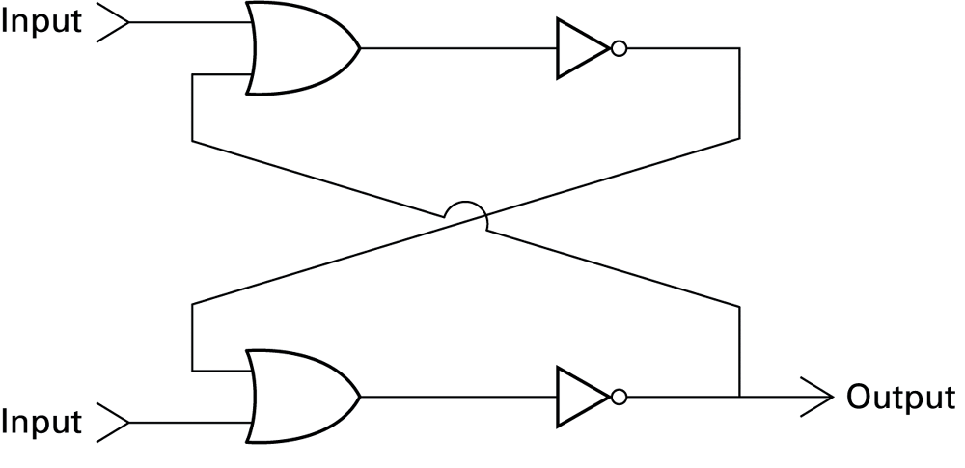
Figure 1.5 Another way of constructing a flip-flop

Slide 15
Hexadecimal Notation
Hexadecimal notation: A shorthand notation for long bit patterns
  Divides a pattern into groups of four bits each
  Represents each group by a single symbol
Example: 10100011 becomes A3

Slide 16
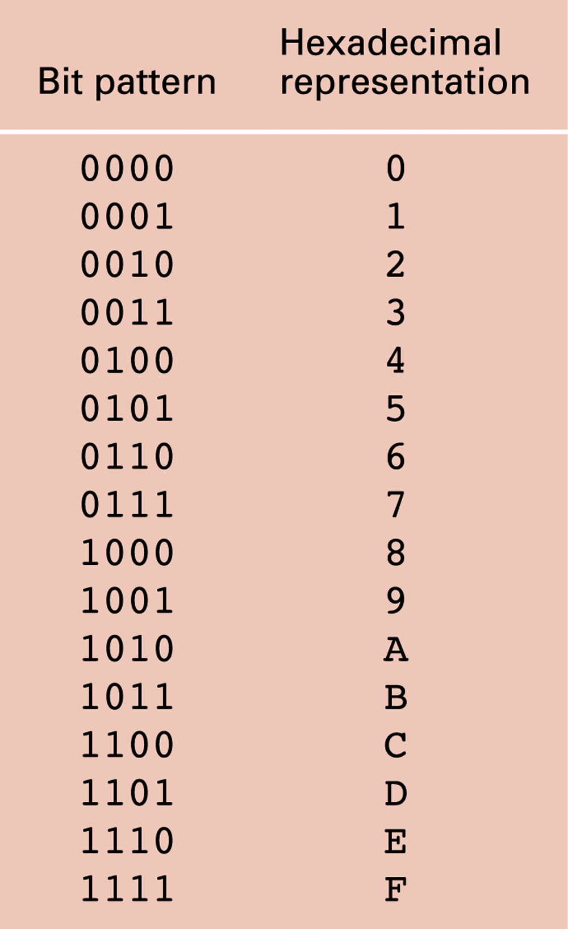
Figure 1.6 The hexadecimal coding system

Slide 17
Main Memory Cells
Cell: A unit of main memory (typically 8 bits which is one byte)
  Most significant bit: the bit at the left (high-order) end of the conceptual row of bits in a memory cell
  Least significant bit: the bit at the right (low-order) end of the conceptual row of bits in a memory cell

Slide 18
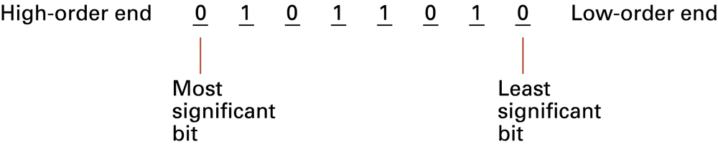
Figure 1.7 The organization of a byte-size memory cell

Slide 19
Main Memory Addresses
Address: A “name” that uniquely identifies one cell in the computer’s main memory
  The names are actually numbers.
  These numbers are assigned consecutively starting at zero.
  Numbering the cells in this manner associates an order with the memory cells.

Slide 20
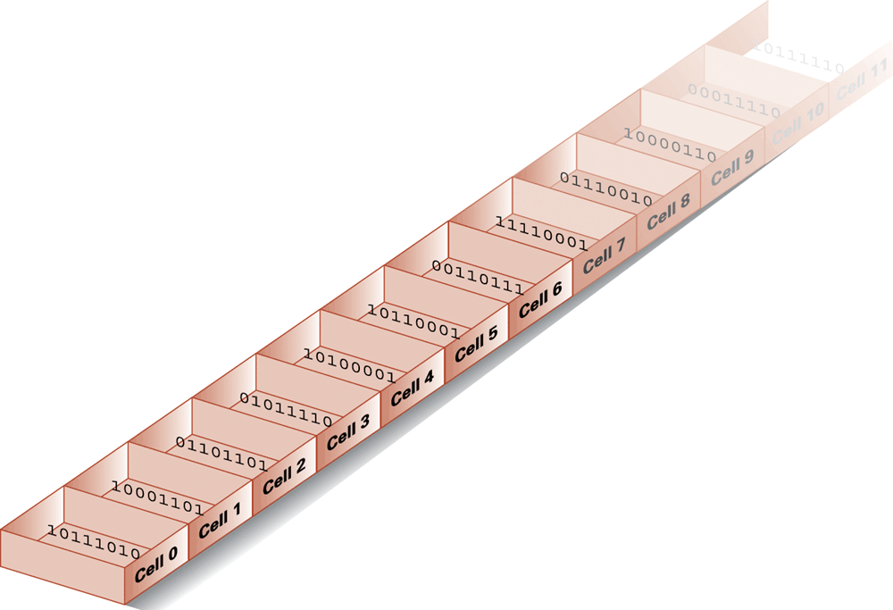
Figure 1.8 Memory cells arranged by address

Slide 21
Memory Terminology
Random Access Memory (RAM): Memory in which individual cells can be easily accessed in any order
Dynamic Memory (DRAM): RAM composed of volatile memory

Slide 22
Measuring Memory Capacity
Kilobyte: 2¹⁰ bytes = 1024 bytes
  Example: 3 KB = 3 times1024 bytes
  Sometimes “kibi” rather than “kilo”
Megabyte: 2²⁰ bytes = 1,048,576 bytes
  Example: 3 MB = 3 times 1,048,576 bytes
  Sometimes “megi” rather than “mega”
Gigabyte: 2³⁰ bytes = 1,073,741,824 bytes
  Example: 3 GB = 3 times 1,073,741,824 bytes
  Sometimes “gigi” rather than “giga”

Slide 23
Mass Storage
On-line versus off-line
Typically larger than main memory
Typically less volatile than main memory
Typically slower than main memory

Slide 24
Mass Storage Systems
Magnetic Systems
  Disk
  Tape
Optical Systems
  CD
  DVD
Flash Drives

Slide 25
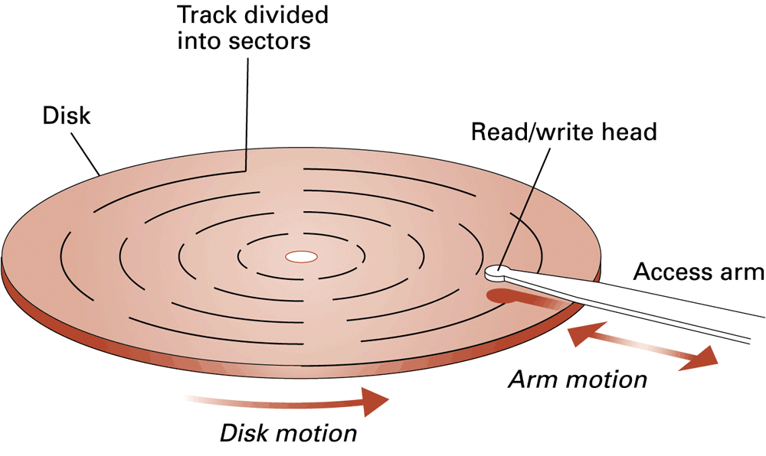
Figure 1.9 A magnetic disk storage system

Slide 26
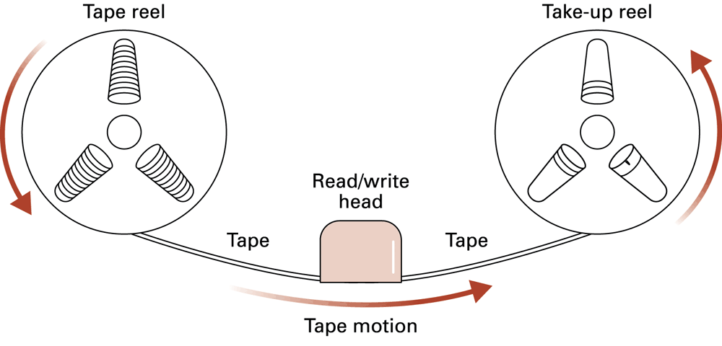
Figure 1.10 Magnetic tape storage

Slide 27
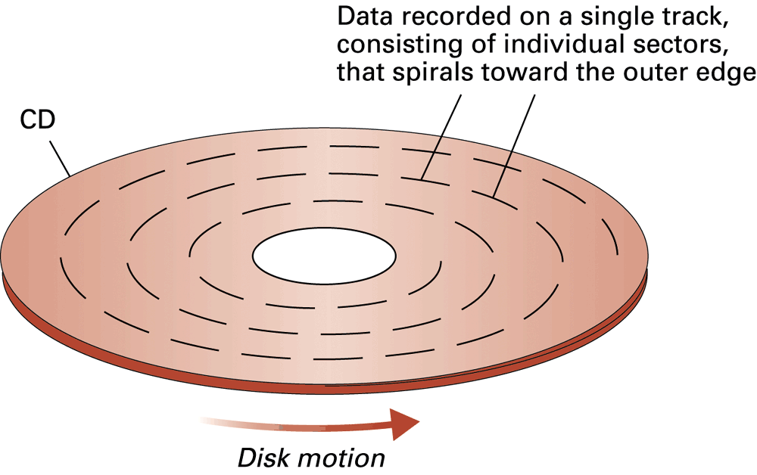
Figure 1.11 CD storage

Slide 28
Files
File: A unit of data stored in mass storage system
  Fields and keyfields
Physical record versus Logical record
Buffer: A memory area used for the temporary storage of data (usually as a step in transferring the data)

Slide 29
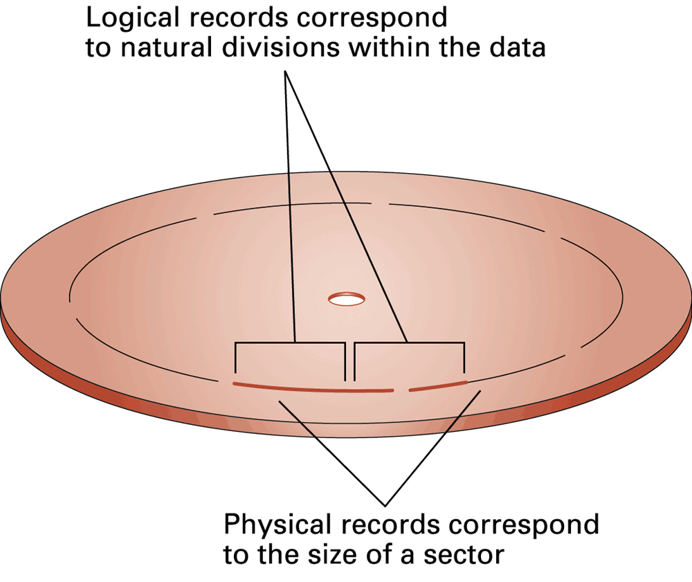
Figure 1.12 Logical records versus physical records on a disk

Slide 30
Representing Text
Each character (letter, punctuation, etc.) is assigned a unique bit pattern.
  ASCII: Uses patterns of 7-bits to represent most symbols used in written English text
  Unicode: Uses patterns of 16-bits to represent the major symbols used in languages world side
  ISO standard: Uses patterns of 32-bits to represent most symbols used in languages world wide

Slide 31
Figure 1.13 The message “Hello.” in ASCII

Slide 32
Representing Numeric Values
Binary notation: Uses bits to represent a number in base two
Limitations of computer representations of numeric values
  Overflow – occurs when a value is too big to be represented
  Truncation – occurs when a value cannot be represented accurately

Slide 33
Representing Images
Bit map techniques
  Pixel: short for “picture element”
  RGB
  Luminance and chrominance
Vector techniques
  Scalable
  TrueType and PostScript

Slide 34
Representing Sound
Sampling techniques
  Used for high quality recordings
  Records actual audio
MIDI
  Used in music synthesizers
  Records “musical score”

Slide 35
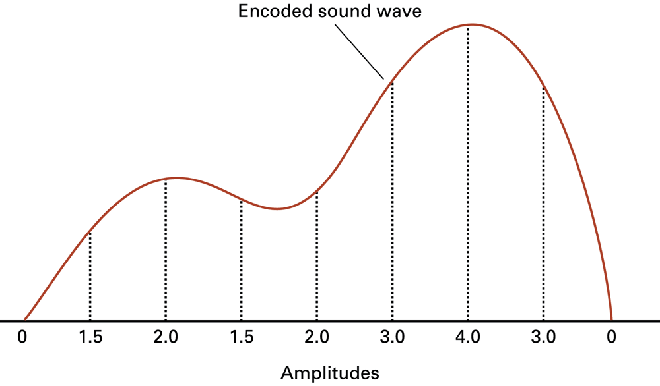
Figure 1.14 The sound wave represented by the sequence 0, 1.5, 2.0, 1.5, 2.0, 3.0, 4.0, 3.0, 0

Slide 36
The Binary System
The traditional decimal system is based
on powers of ten.
The Binary system is based on powers
of two.

Slide 37
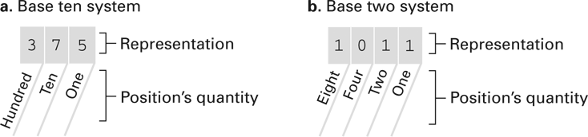
Figure 1.15 The base ten and binary systems

Slide 38
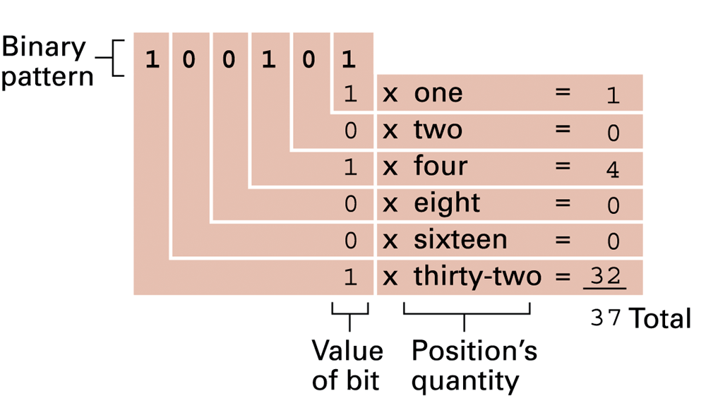
Figure 1.16 Decoding the binary representation 100101

Slide 39
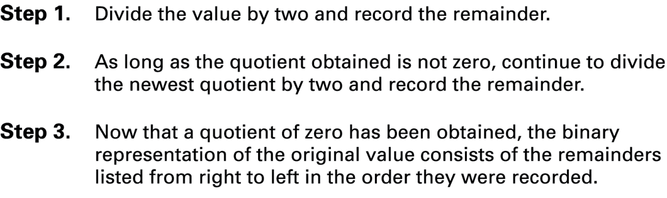
Figure 1.17 An algorithm for finding the binary representation of a positive integer

Slide 40
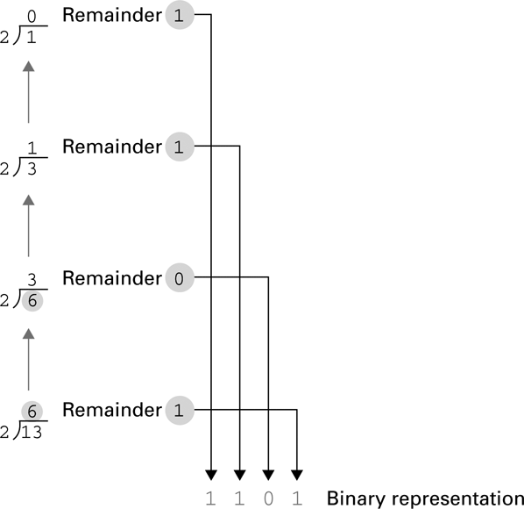
Figure 1.18 Applying the algorithm in Figure 1.15 to obtain the binary representation of thirteen

Slide 41
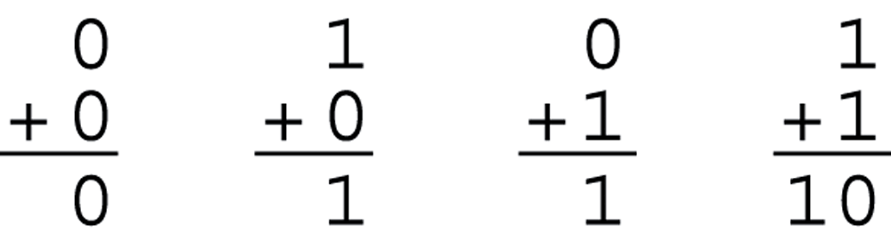
Figure 1.19 The binary addition facts

Slide 42
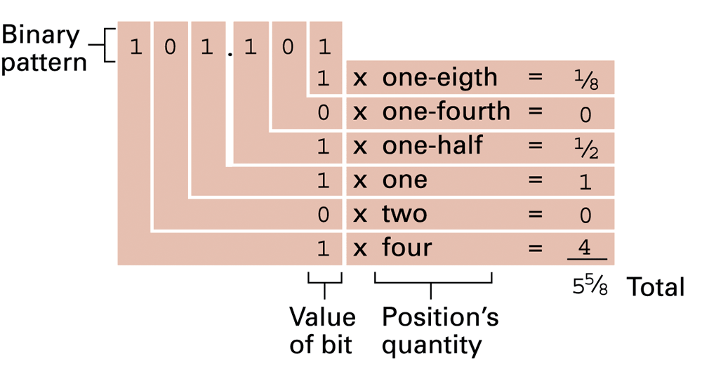
Figure 1.20 Decoding the binary representation 101.101

Slide 43
Storing Integers
Two’s complement notation: The most popular means of representing integer values
Excess notation: Another means of representing integer values
Both can suffer from overflow errors.

Slide 44
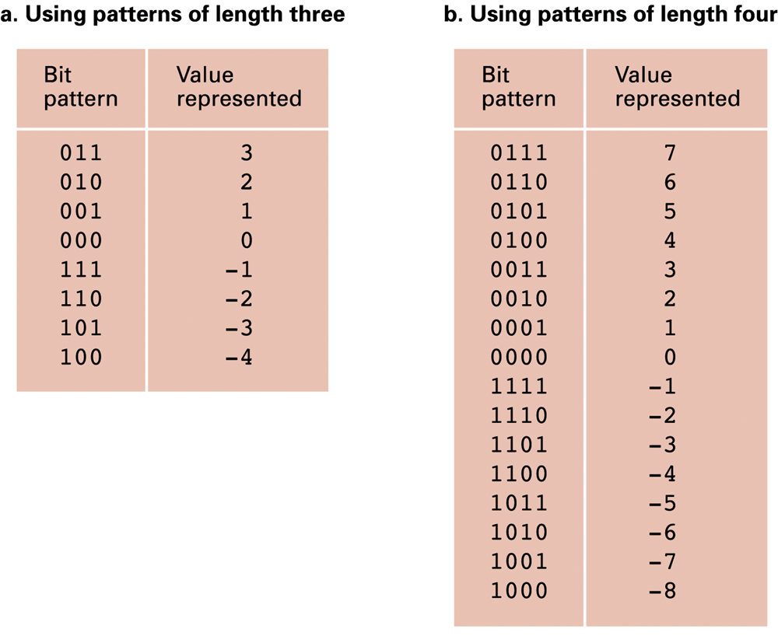
Figure 1.21 Two’s complement notation systems

Slide 45
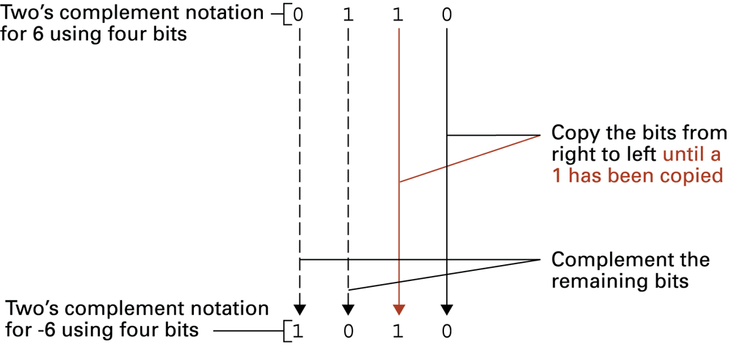
Figure 1.22 Coding the value -6 in two’s complement notation using four bits

Slide 46
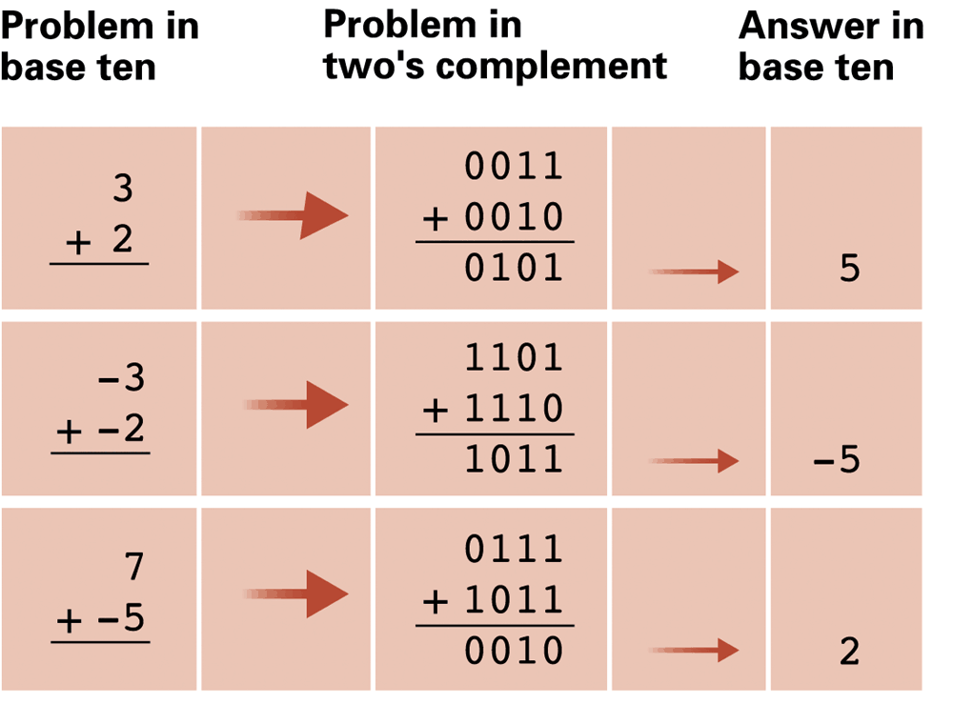
Figure 1.23 Addition problems converted to two’s complement notation

Slide 47
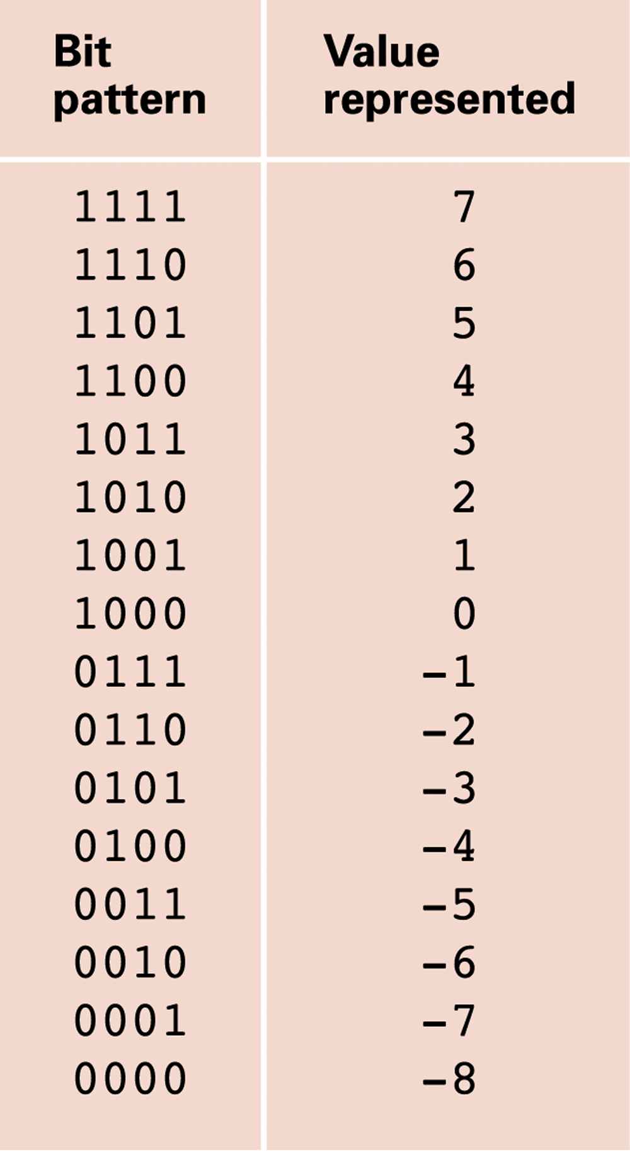
Figure 1.24 An excess eight conversion table

Slide 48
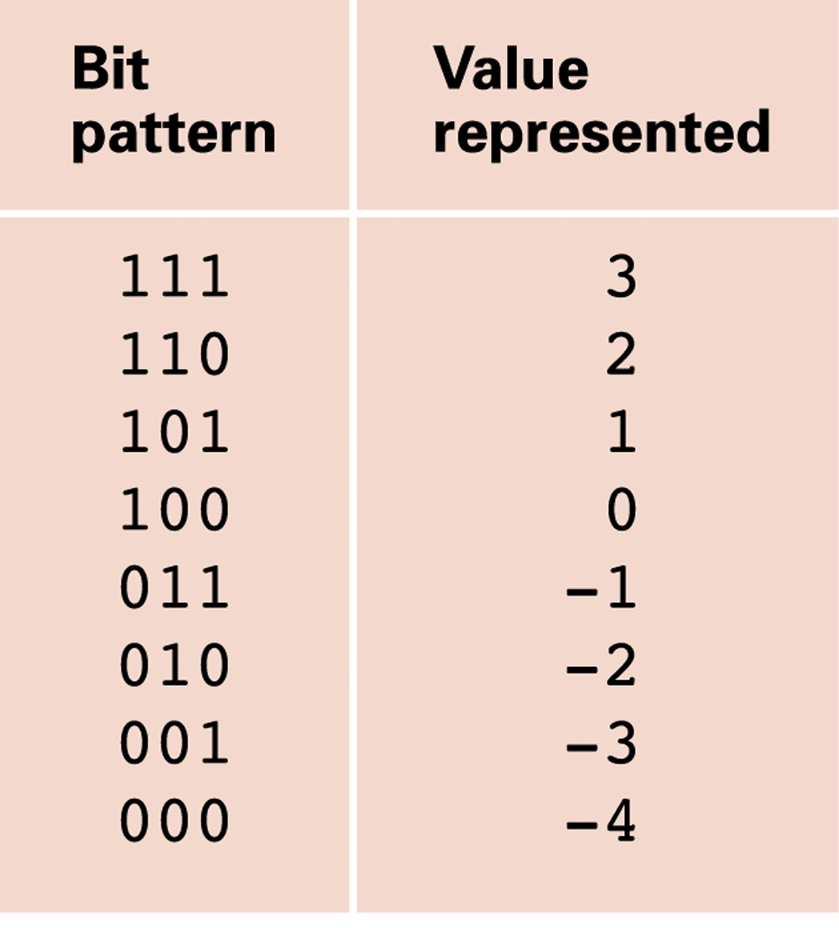
Figure 1.25 An excess notation system using bit patterns of length three

Slide 49
Storing Fractions
Floating-point Notation: Consists of a sign bit, a mantissa field, and an exponent field.
Related topics include
  Normalized form
  Truncation errors

Slide 50
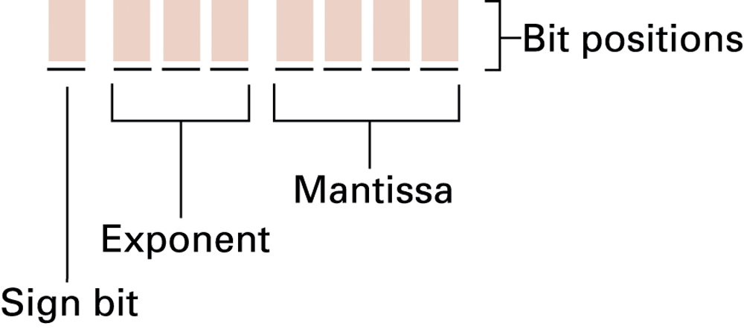
Figure 1.26 Floating-point notation components

Slide 51
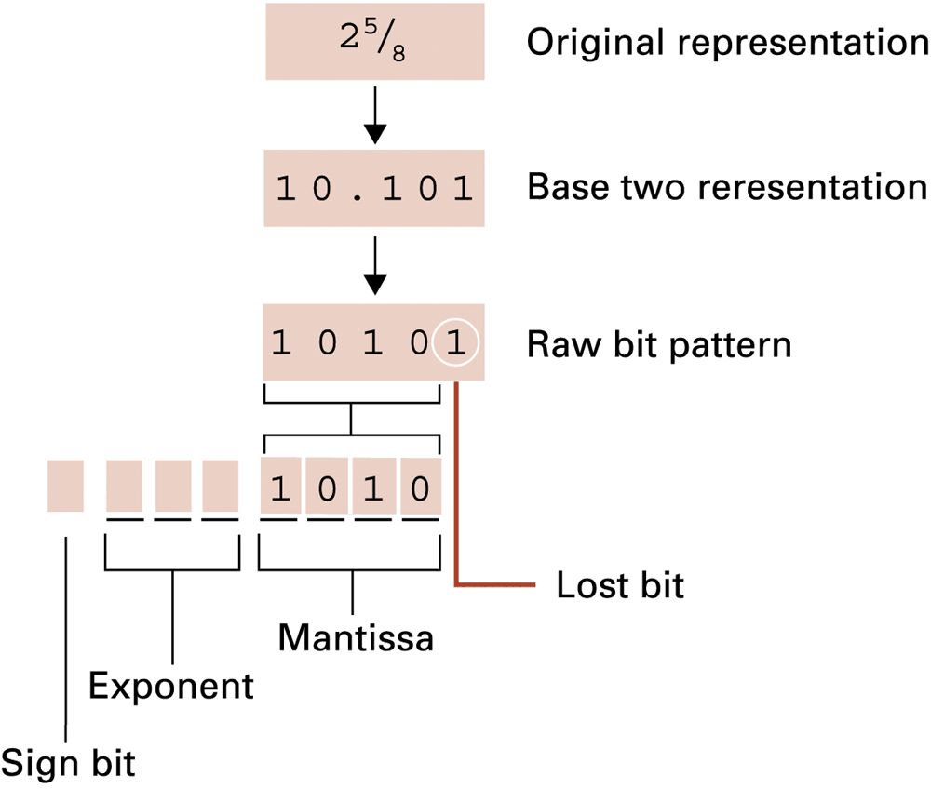
Figure 1.27 Encoding the value
2 5⁄8

Slide 52
Data Compression
Lossy versus lossless
Run-length encoding
Frequency-dependent encoding
(Huffman codes)
Relative encoding
Dictionary encoding (Includes adaptive dictionary encoding such as LZW encoding.)

Slide 53
Compressing Images
GIF: Good for cartoons
JPEG: Good for photographs
TIFF: Good for image archiving

Slide 54
Compressing Audio and Video
MPEG
  High definition television broadcast
  Video conferencing
MP3
  Temporal masking
  Frequency masking

Slide 55
Communication Errors
Parity bits (even versus odd)
Checkbytes
Error correcting codes

Slide 56
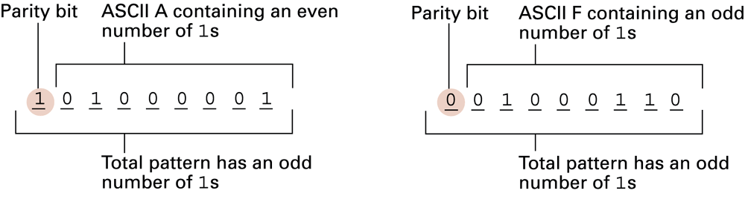
Figure 1.28 The ASCII codes for the letters A and F adjusted for odd parity

Slide 57
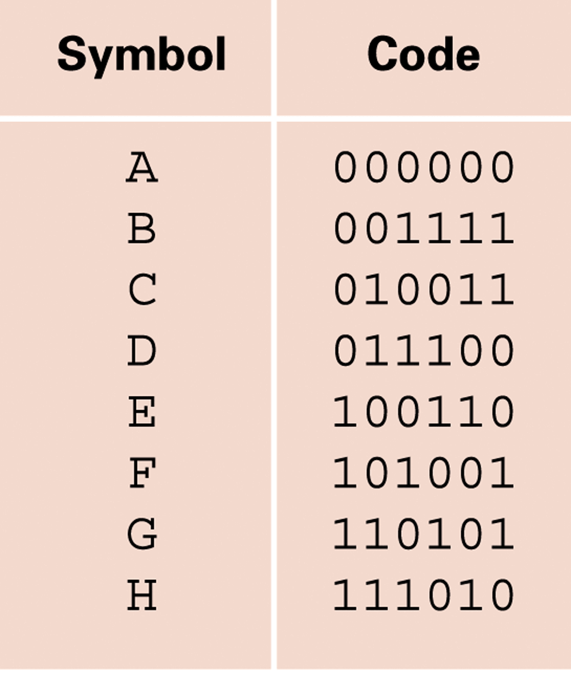
Figure 1.29 An error-correcting code

Slide 58
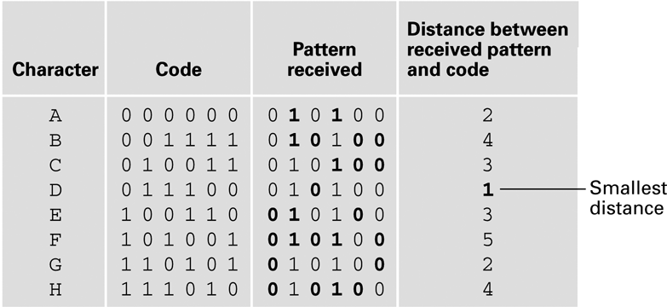
Figure 1.30 Decoding the pattern 010100 using the code in Figure 1.30

